Slide 1

Java 11
New features

Slide 2
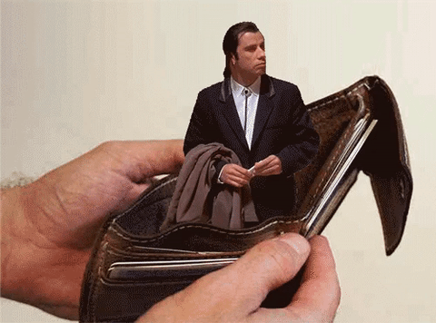
Upgrading from Java 8 sounds scary
I don’t want to pay for java

Slide 3

Upgrading from Java 8 sounds scary
Super happy with java 8, thanks!

Slide 4
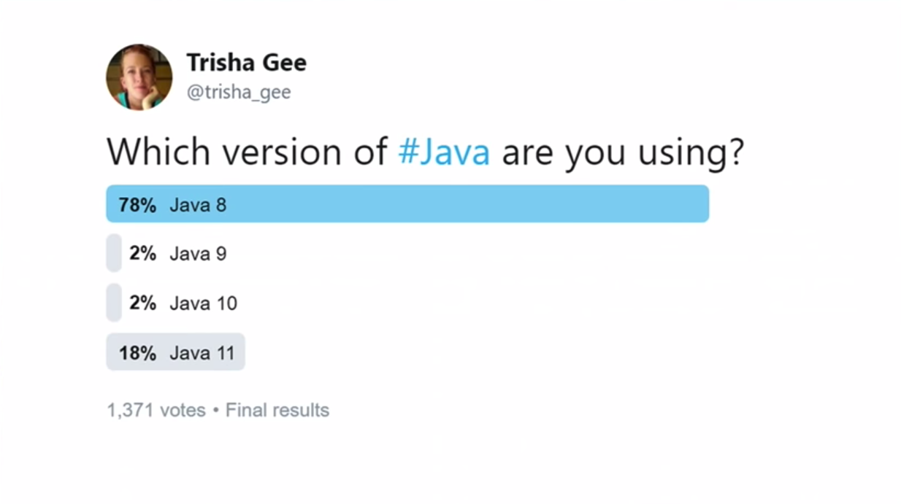

Slide 5

Releases & Updates

Slide 6
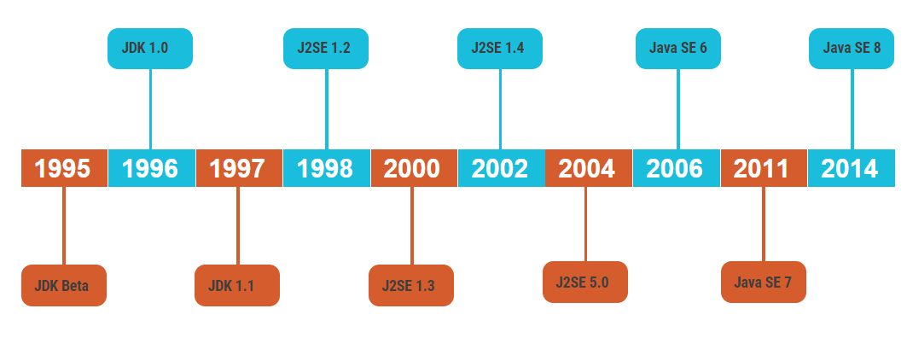
Releases until JAVA 8

Slide 7
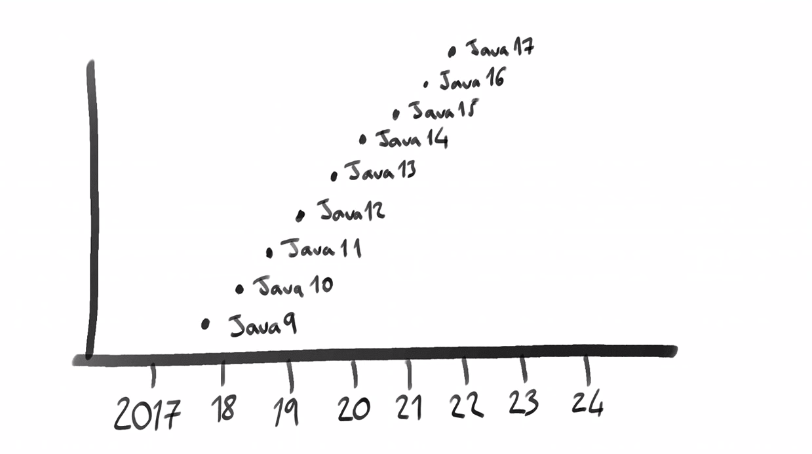
Releases after JAVA 8 (Releses of JAVA every six months)

Slide 8
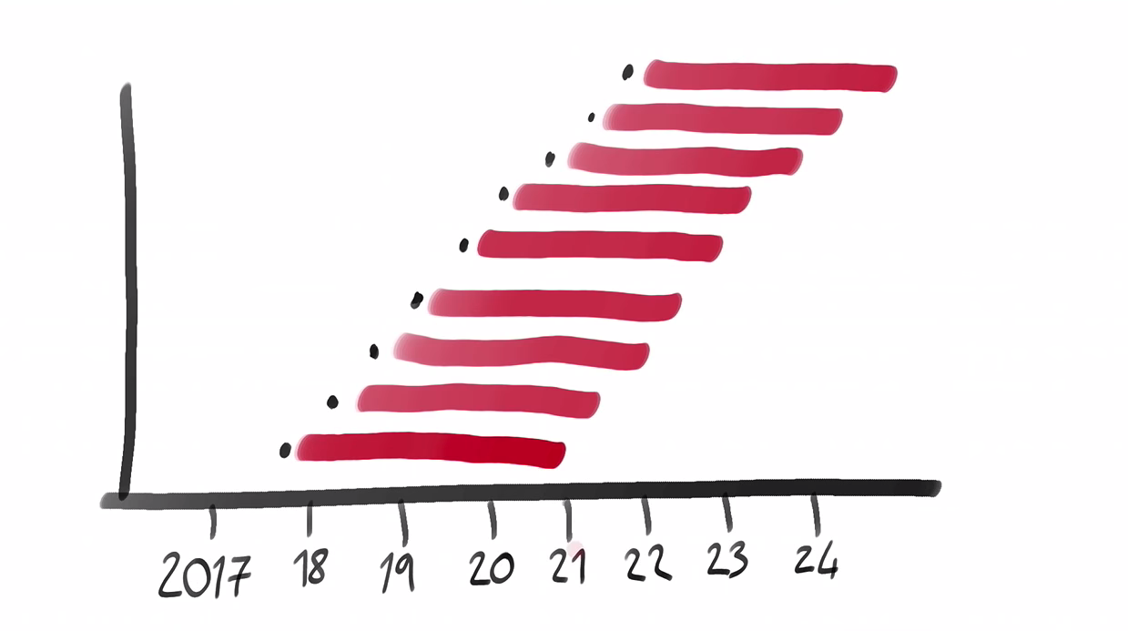
Releases after JAVA 8

Slide 9
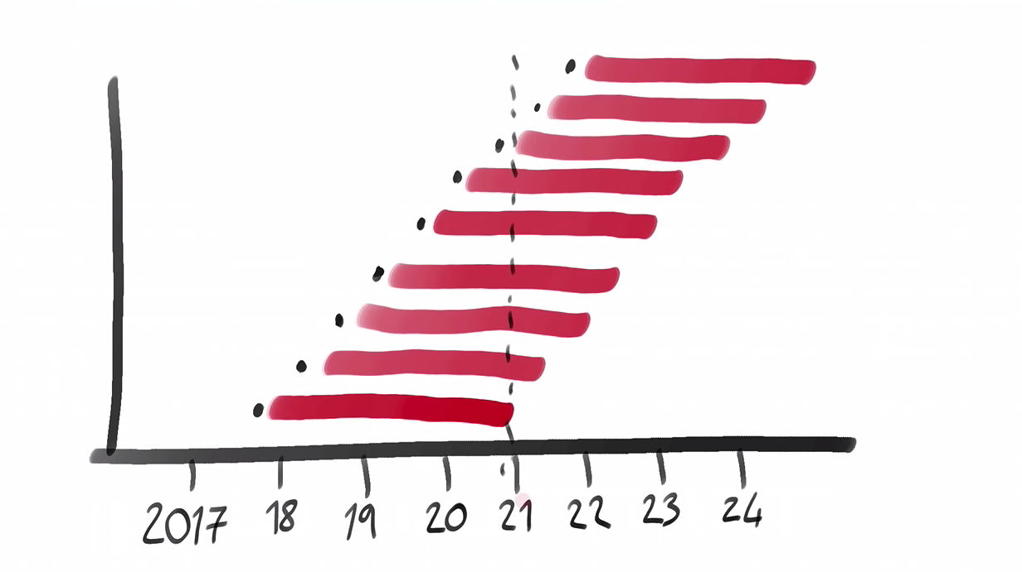
Releases after JAVA 8

Slide 10
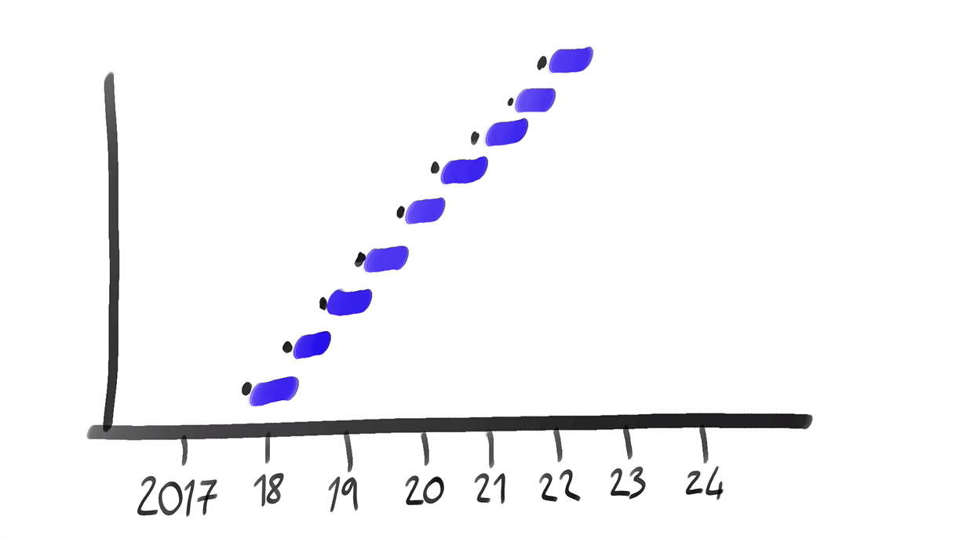
Releases after JAVA 8 – supporting and updating

Slide 11
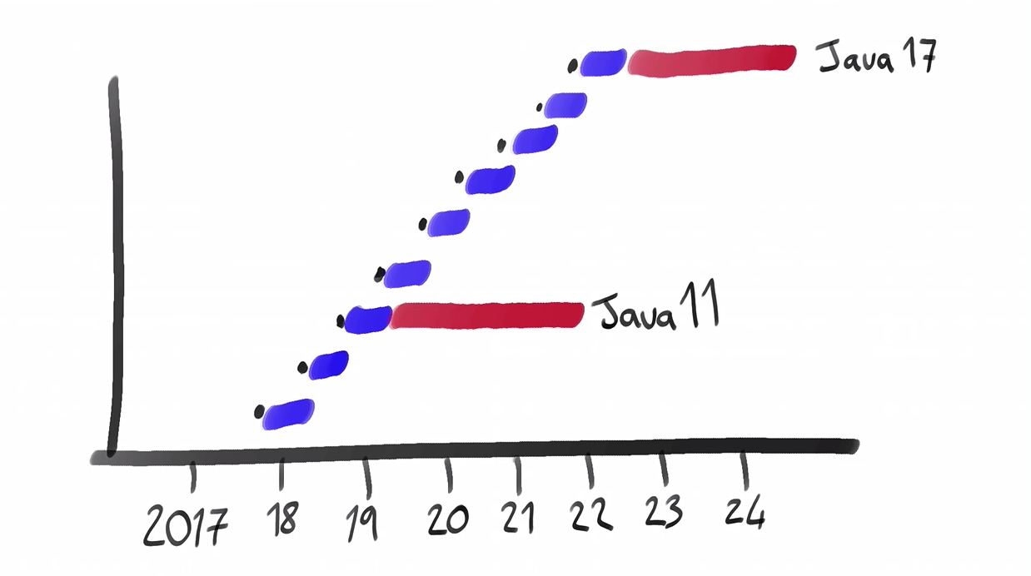
Releases after JAVA 8
-> Interim Releases -> LTS (Long term support) releases

Slide 12
Licensing

Slide 13
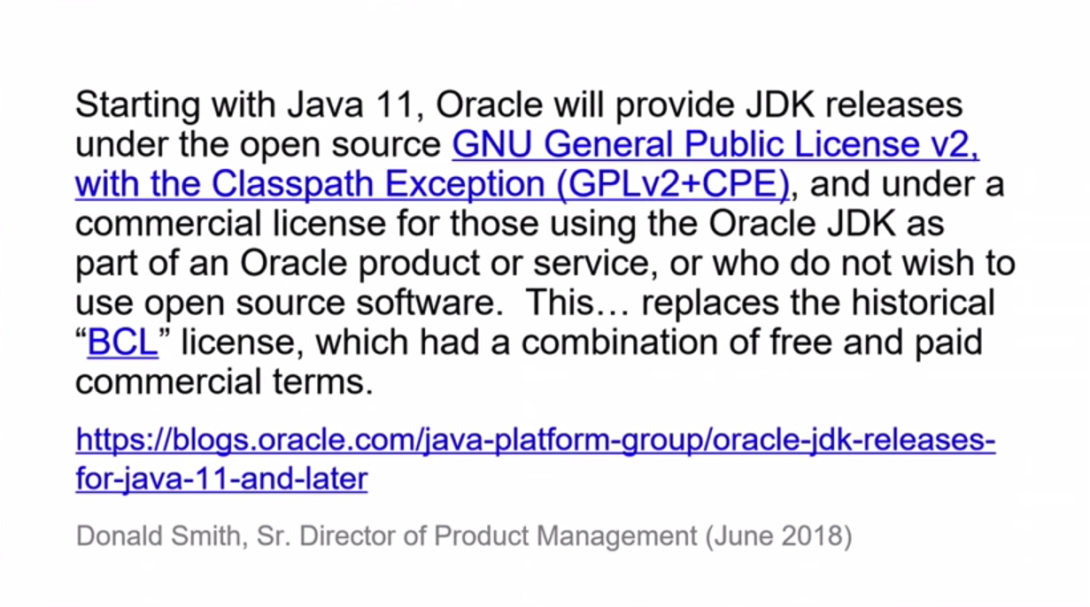
Licensing

Slide 14

That sounds overly complicated. Talk us through it.

Slide 15
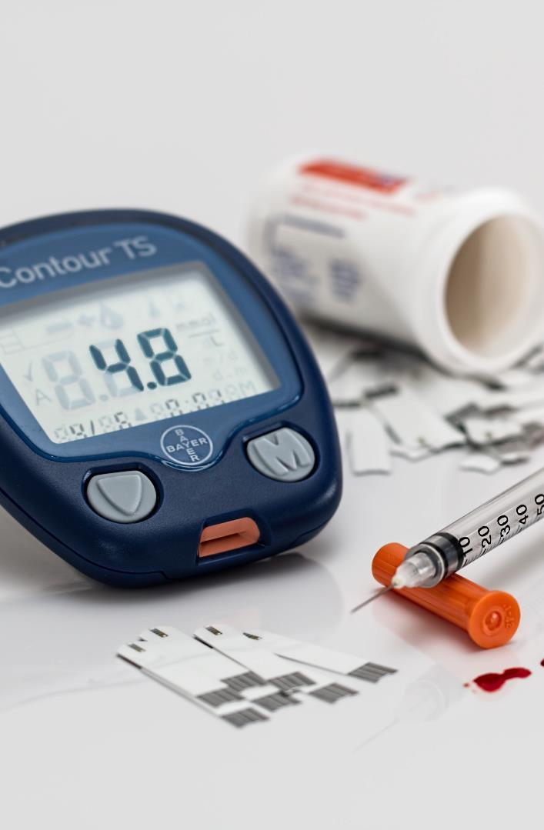


Solution
Free
Commercial
OpenJDK
But will be replaced every 6 months
Oracle JDK
But you have to pay to use it in production

Slide 16
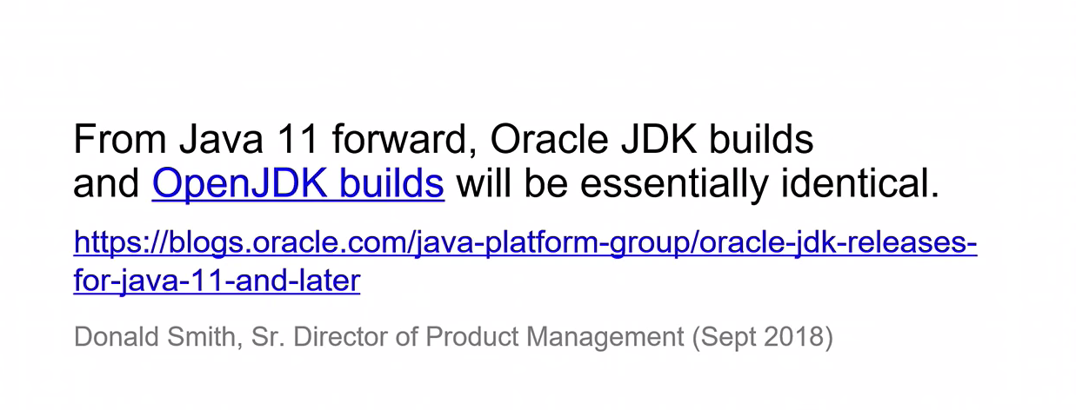
Licensing

Slide 17
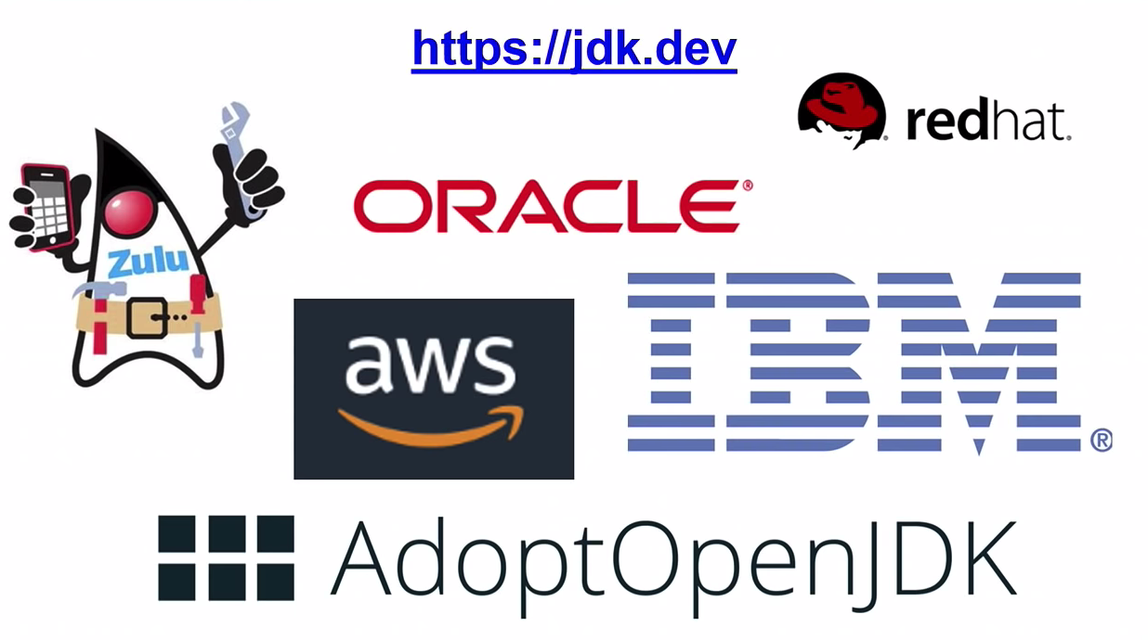
Licensing OpenJDK vendors

Slide 18

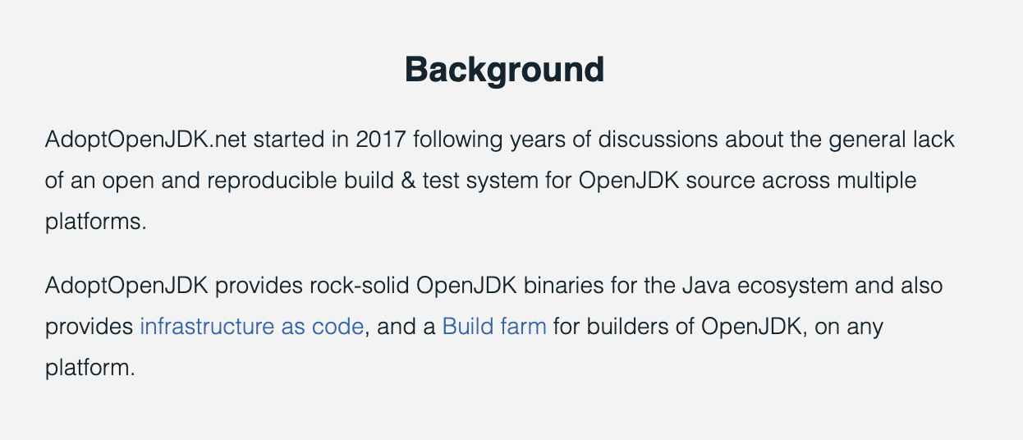
Licensing

Slide 19
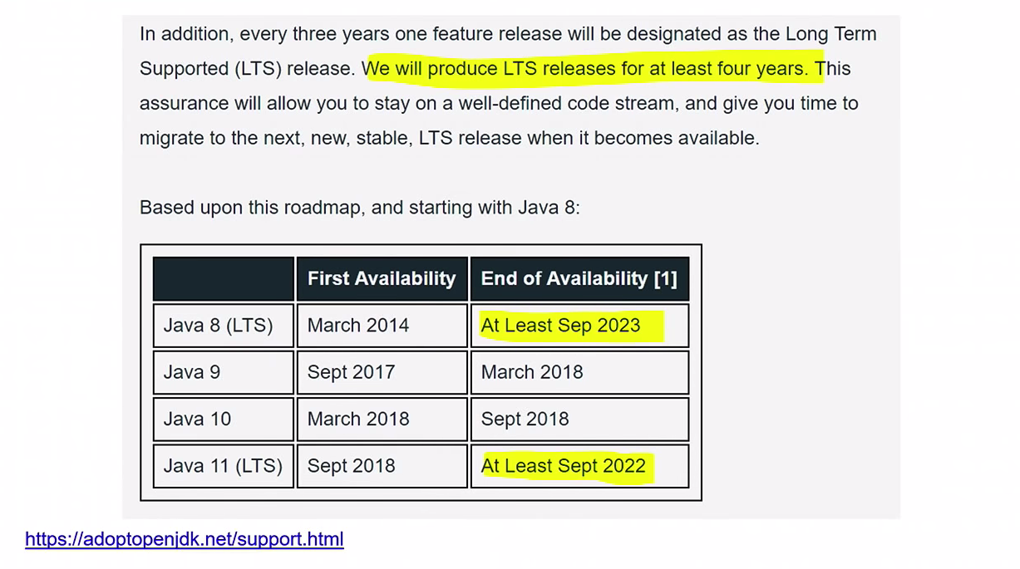
Licensing

Slide 20

Some New Features from JAVA 11
Show me the code

Slide 21
Some New Features from JAVA 11
Jshel
VAR
Collection factories
list.of
Map.of
Stream
Optional
Multi release jar Files
Switch expressions
Show me the code

Slide 22
Performance
Memory Usage
Garbage collector improvements
Show me the code

